Slide 1
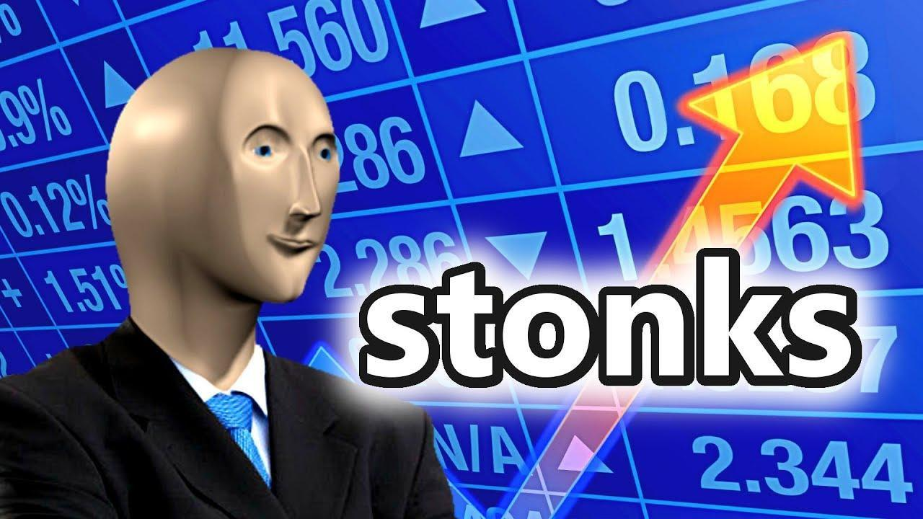

Slide 2
COVID-19 and Pop Culture Stocks
An Analysis of Producers vs. Distributors During Economic Downturns

Slide 3
Research Question
How exactly did COVID-19 affect Pop culture companies, and what can we learn for a potential period of economic downturn?

Slide 4
Task
Use yLibrary to take a look at current and past stock returns of 8 pop culture companies (Netflix, Warner Bros, Kartoon Studios, Sony(Crunchyroll), Disney, Funko, GameStop, Hasbro)
Web scrape websites to find yearly revenue and yearly rate of change
Take a look at numbers pre, during, and post COVID
Predict future returns using Time Series Regression

Slide 5
Tools
Tech stack will be pretty simple. I will make use of:
Python (Web scraping APIs, Visualization, and other Libraries)
Spreadsheets(Going to have a lot of structured data on my hands)
Slides (Making a presentation about my results)

Slide 6
Goal
To analyze how COVID-19 impacted pop culture companies across different business models (producers vs. distributors).
To measure stock price and revenue changes before, during, and after COVID.
To use time series regression to predict how these companies may perform in future economic downturns.
Most importantly, to draw lessons for Cooledtured about which strategies or models are most resilient in times of crisis.

Slide 7
Important Terms
Before we get started, there are some terms I have to define:
NASDAQ: Tech-heavy stock exchange for publicly traded companies
Stock Price: Total value of a company’s shares.
Percent Change: Relative increase/ decrease in a company’s revenue over the last year.
Revenue: Total company income
Y-Finance: Python API for stock market data
Producers: Company’s who create and finance Content
Distributors: Company’s who sell, retail, and distribute products

Slide 8
PRODUCERS

Slide 9
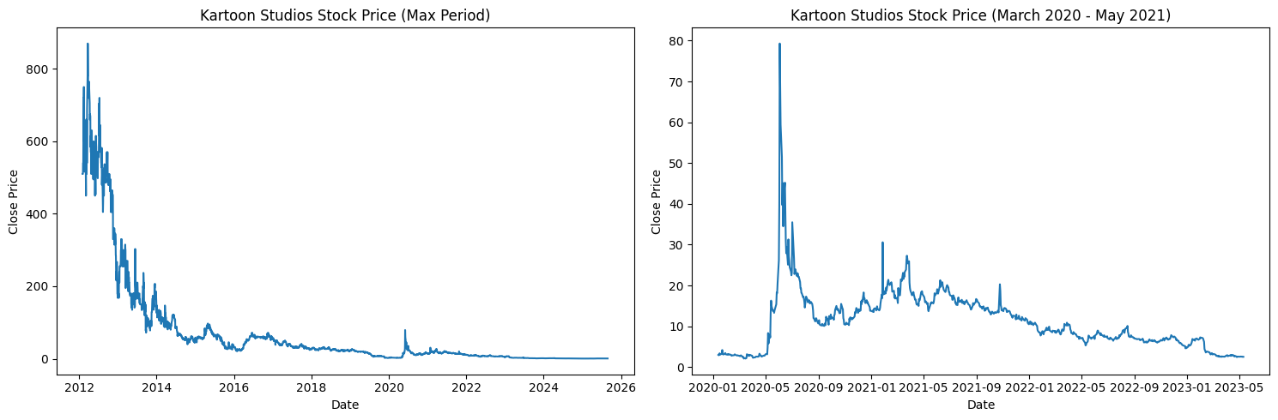
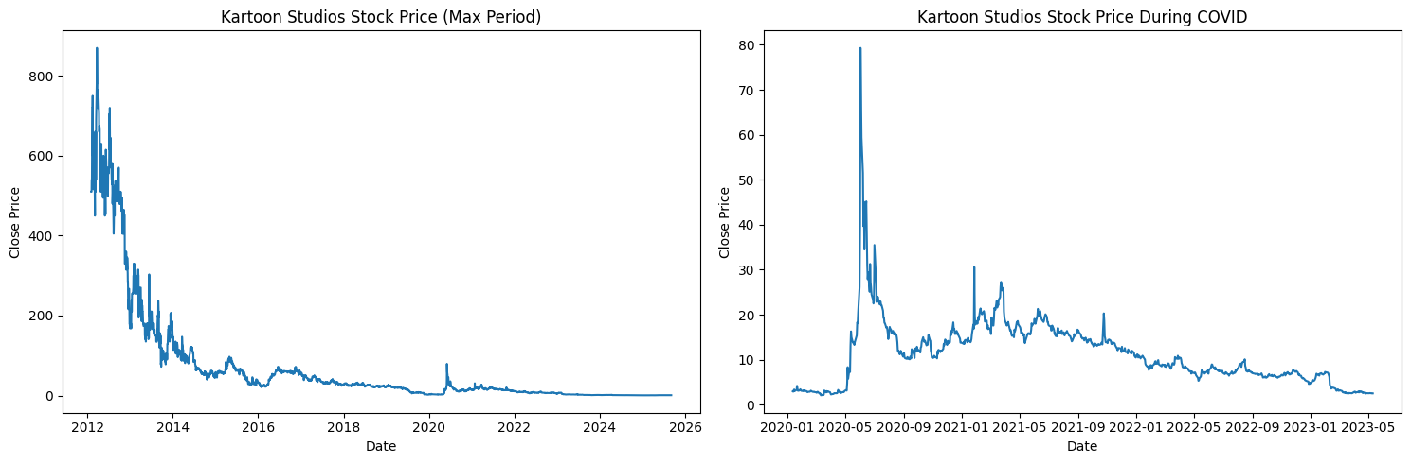
Kartoon Studios(Stock Price)
Sharp decline during COVID → weak recovery after

Slide 10
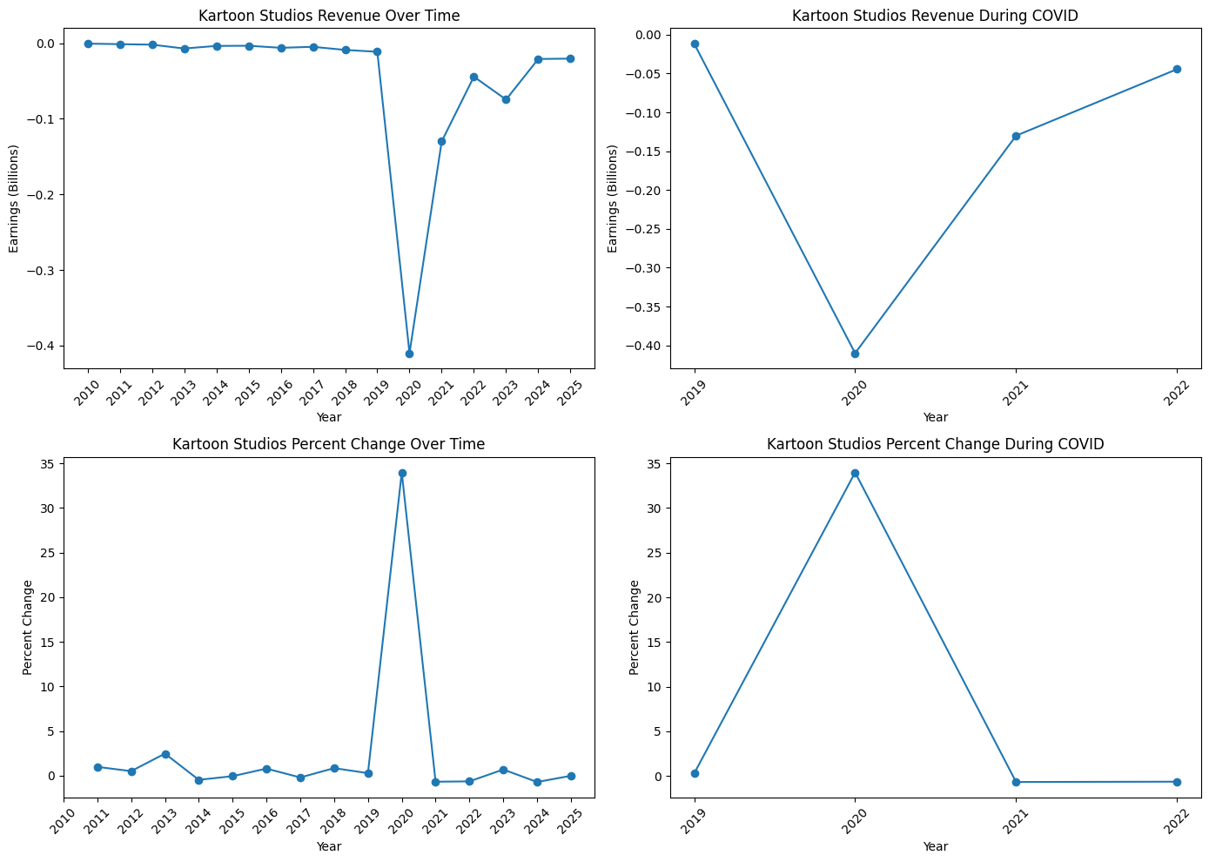
Kartoon Studios (Revenue)

Slide 11
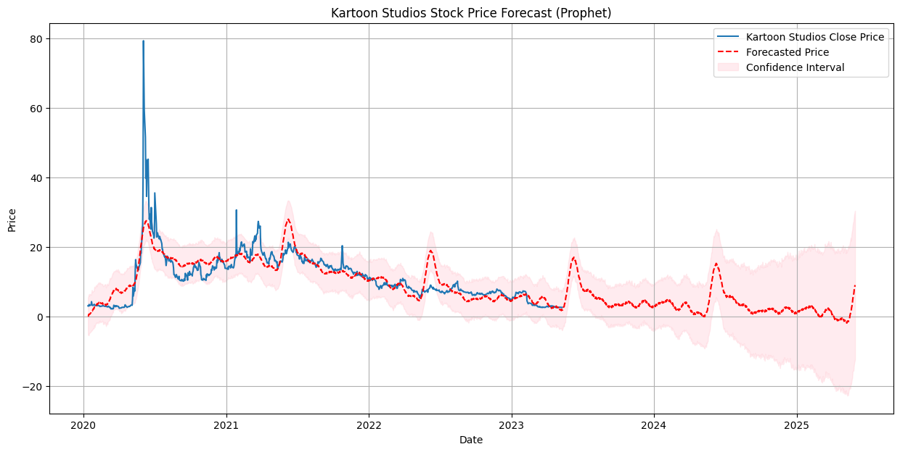
Kartoon Studios (Predicted Stock)
Modest future recovery, however it is lagging behind industry peers, and does not recover pre-pandemic numbers

Slide 12
Insights
Vulnerable to production shutdowns
Struggled to adapt quickly during crisis
Over performance during and post pandemic, not good.

Slide 13
BOTH

Slide 14
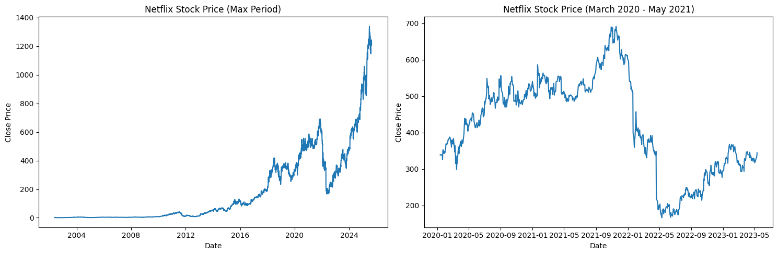
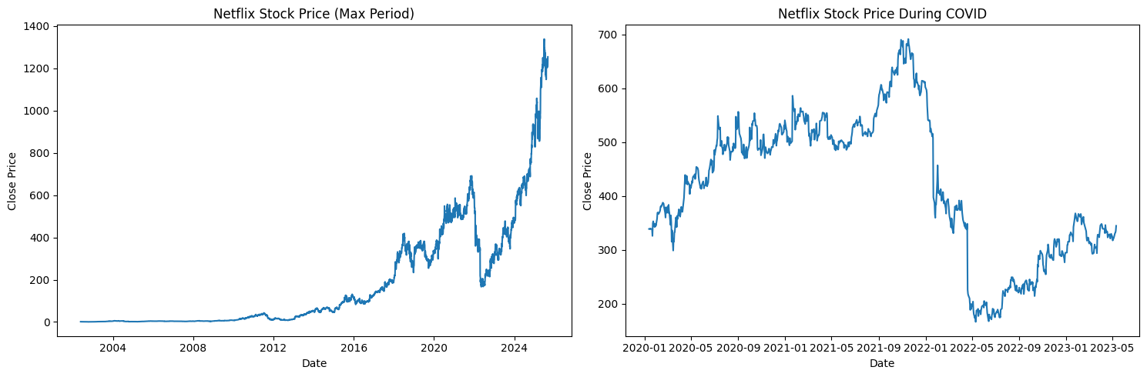
Netflix(Stock Price)
Strong upward surge during COVID demand spike before eventual fall and growth

Slide 15
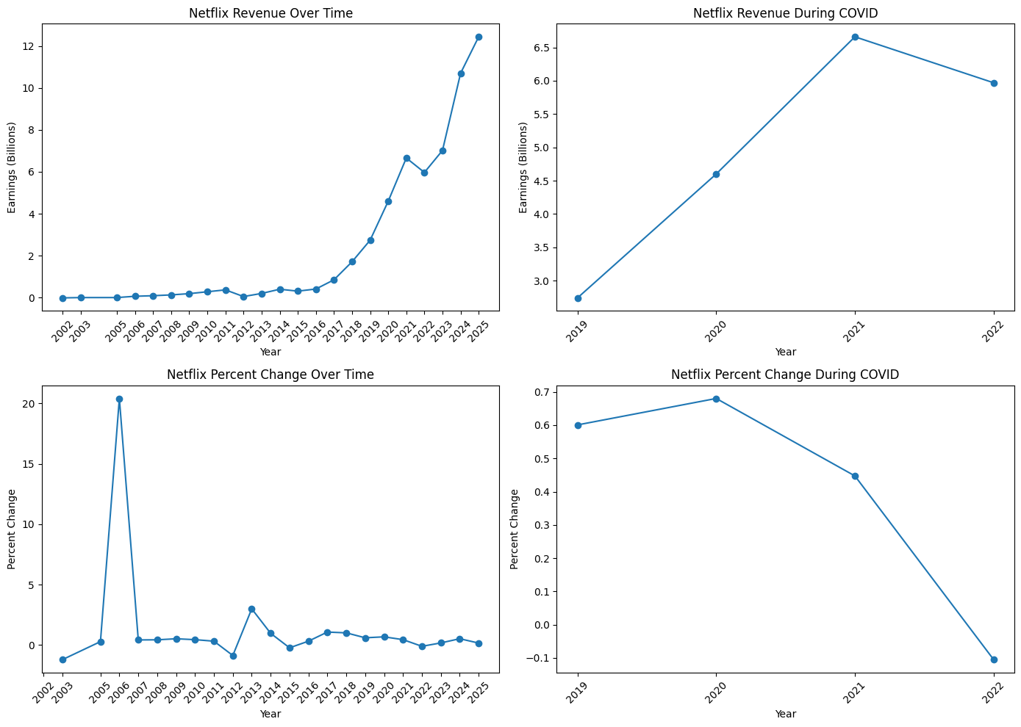
Netflix(Revenue)
Sustained subscription growth during lockdowns
Sustained subscription growth during lockdowns

Slide 16
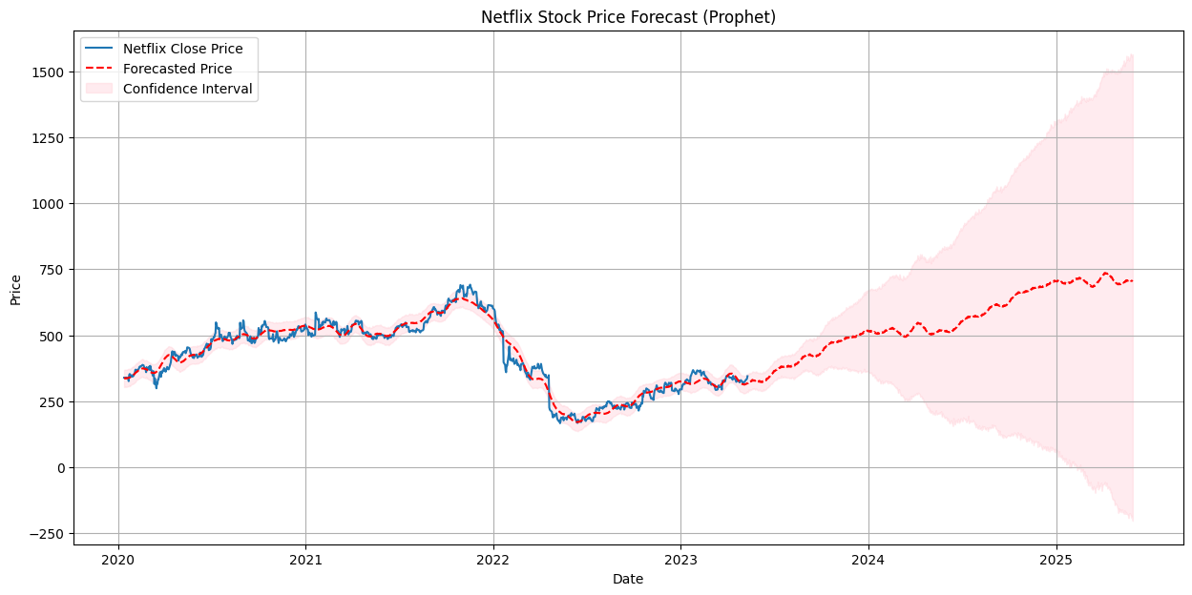
Netflix(Predicted Stock)
Long-term stabilization after COVID boom

Slide 17
Insights
Digital-first model thrived during pandemic
Demand for streaming offset market downturns
Flexible supply chain + subscription model = resilience and growth
Stayed strong and continued to grow as time went on.

Slide 18
Distributors

Slide 19
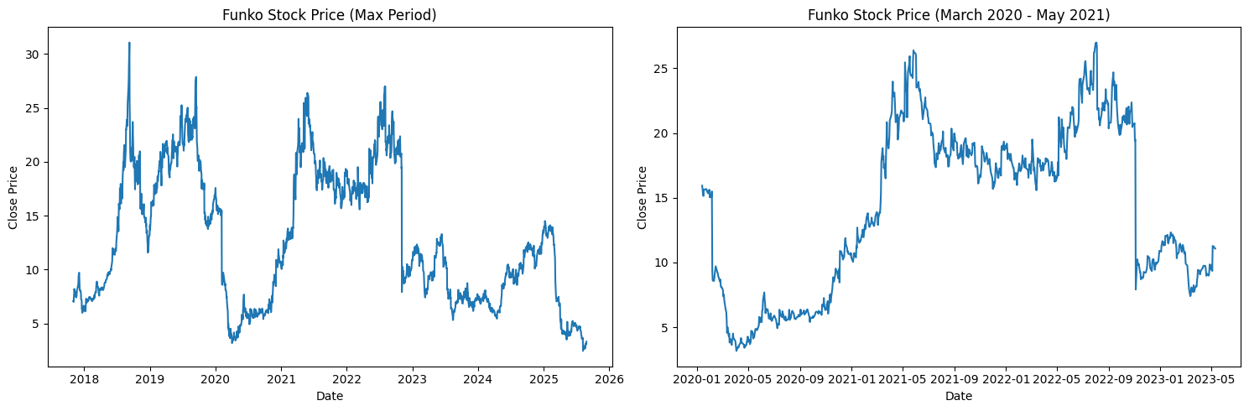
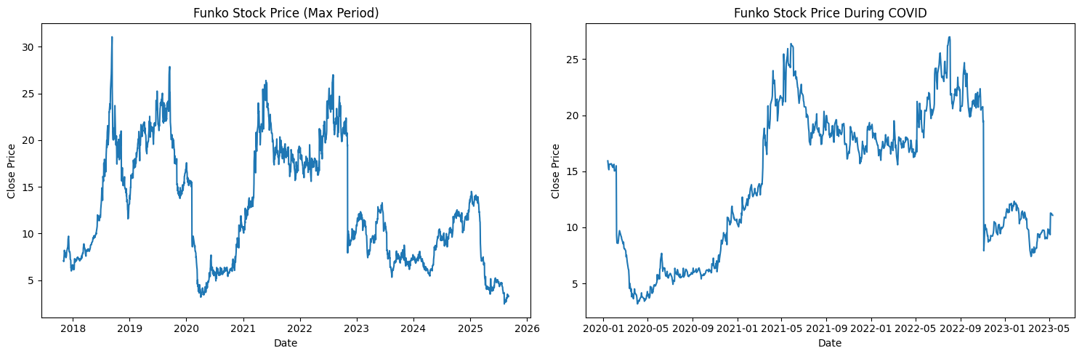
Funko (Stock Prices)
Strong Growth During COVID and then a sharp fall after.

Slide 20
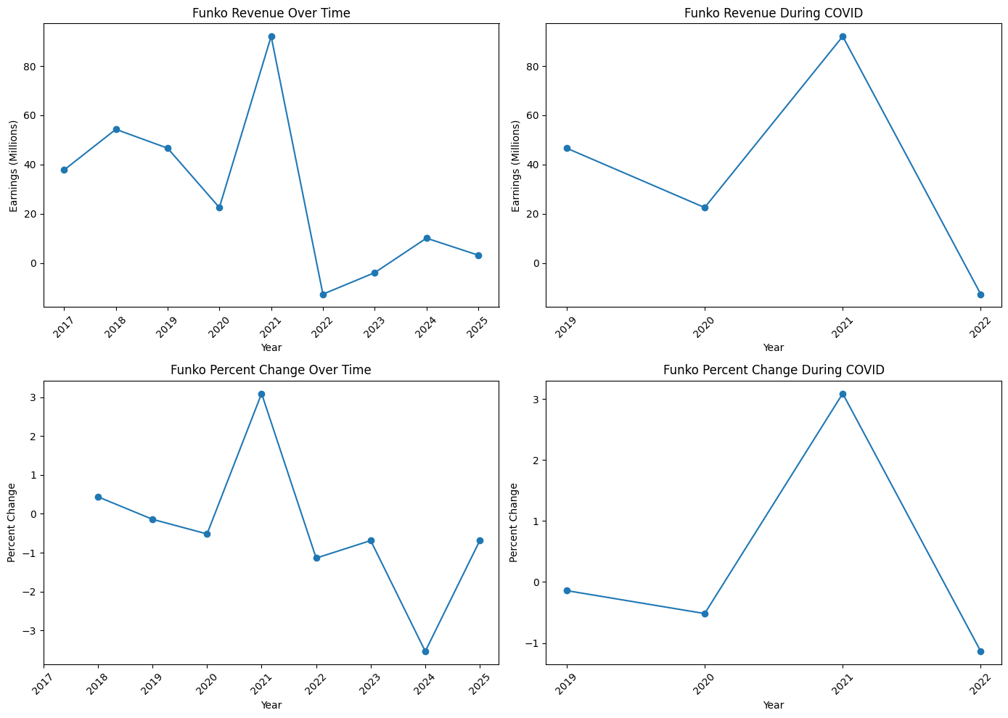
Funko (Revenue)

Slide 21
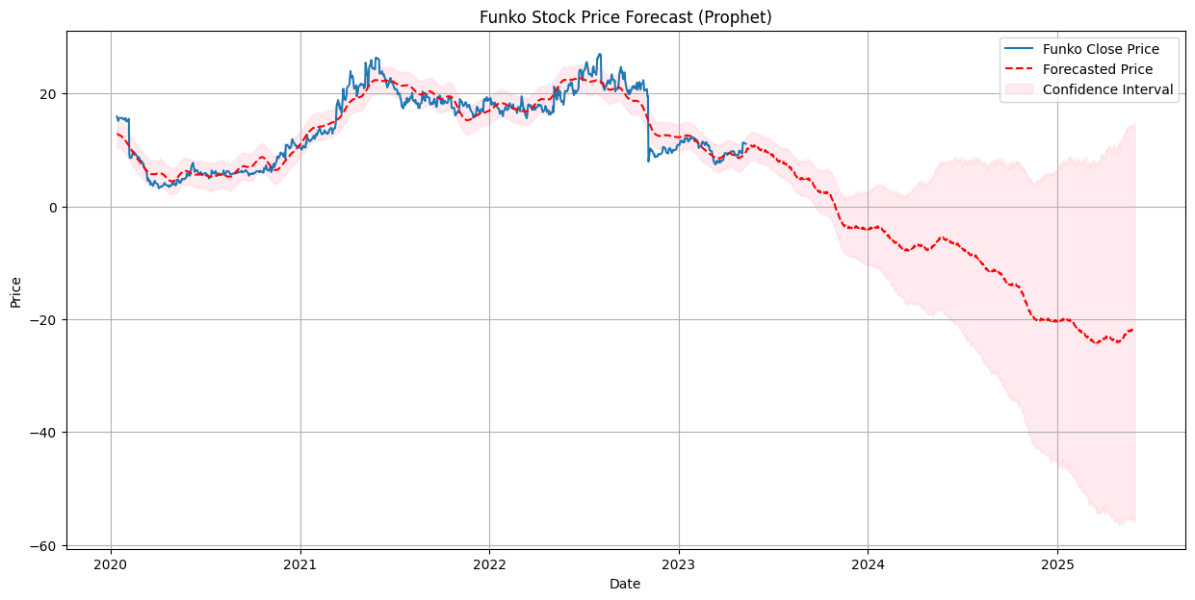
Funko (Predicted Stock)
Continued downturn expected

Slide 22
Insights
Collectibles benefitted from pop culture resurgence
Revenue growth outpaced producers
Distributors better positioned in downturns
However, they failed to innovate and so their stock price and overall revenue fell. A lesson for companies Cooledtured to learn from.

Slide 23
What does this all mean?
Producers Suffer the most during hard recessions, and Distributors reap the most benefits
This means that companies like Funko (and Cooledtured) are likely to see an increase in stock price and revenue during periods of economic downturn
So, there is good in the bad for Cooledtured. Assuming things do take a nosedive, of course.
That said, as seen with Netflix, those who have flexible supply chains, and digitalized their products reaped the most benefits.

Slide 24
Lessons for Cooledtured

Slide 25
What does this mean?
Opportunities in downturns: As a distributor/lifestyle company, Cooledtured could see increased demand during recessions, similar to Funko.
Pop culture resilience: Collectibles and fandom-driven products remain popular even in tough economies.
Digital + community advantage: Strong online presence and engagement could buffer against physical retail slowdowns.
Strategic lesson: If economic conditions worsen, Cooledtured can lean into its community-driven model to grow while producers struggle.

